Slide 1
“Data Types” in Tableau
By
Hemant Gupta
(Group-1)

Slide 2
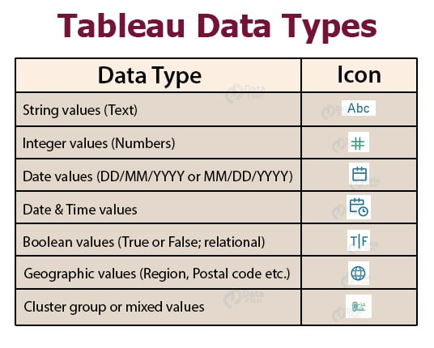
Introduction
All field in a data source have a data type. The data type reflects the kind of information stored in that field, for example integers, dates, string etc. Each data type of a field is identified in Data pane by one of the icon.

Slide 3
String data type The string data type consists of zero or more characters, meaning it is a text data type. A value is a string when the characters are enclosed in a single or double quote. For instance, a string value can be "Orange" or "This is an Orange," etc.
Date and Time Data Type
Tableau can work with different date and time formats like dd-mm-yy , mm-dd-yyyy etc. The time data values are a decade, year, quarter, month, hour, minute, second, etc. As the user enters data and time values, Tableau automatically classifies it under Date data type and Date & Time data value.
Example: 23-10-1999, 10-25-2002

Slide 4
Numerical Data Type Numeric values can be of two types, Integer: These are whole values without any fractions. For example, 10, -4, 0, etc. Floating Point: These values contain a fraction. For example, 2.56, 5.00, 6.65, etc. Floating Point values can store numbers only up to a specific limit. Tableau also provides a Round() function, which is used to round up the float values.
Boolean Data Type
In Tableau, the Boolean data type represents a value that can be either true or false. Boolean values are formed as a result of relational calculations. Boolean values can also be expressed using 1 or 0. A relational calculation can also result in an unknown outcome; NULL values represent it.
Example: "age > 21", the result can either be "True" or "False."

Slide 5
Geographic Values Geographic data values are used in maps. These data types are denoted by a globe icon. It includes country name, state name, city, region, postal codes, etc. It associates each value in a field with latitude and longitude values. With the geographic data type in Tableau, you can plot data points on maps, create heat maps, perform spatial analysis, and conduct geospatial visualizations. Example: 19.0760° N, and 72.8777° E, Mumbai, 400001.
Cluster or Mixed Data type
Sometimes data set contains values having a mixture of data types. Such values are known as cluster group values or mixed data values. In such a situation, users have the option either to handle it manually or allow Tableau to operate on it.

Slide 6
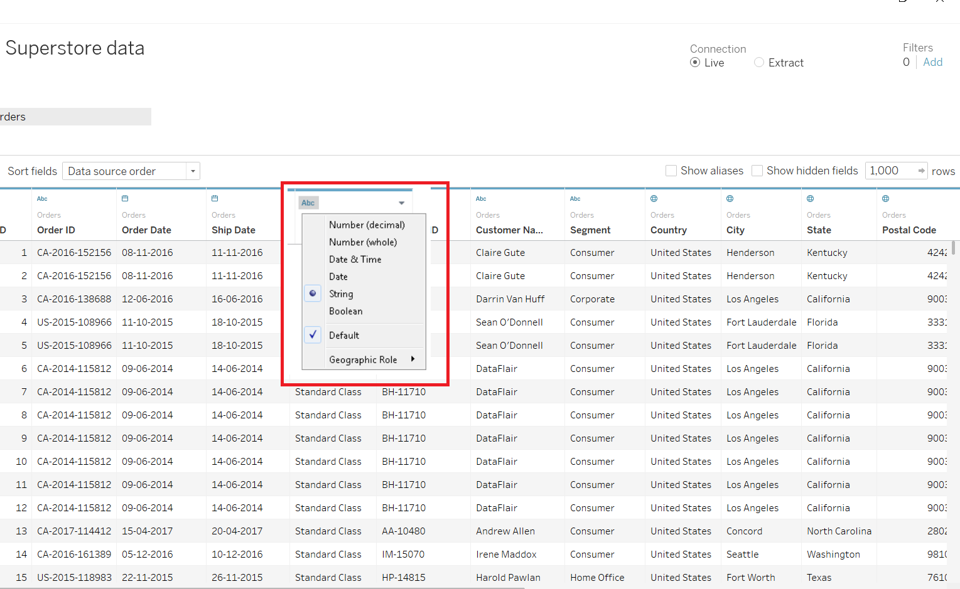
Change Data Types in Tableau 1. Changing data type of a field in Data Source page To change the data type of a field from the Data Source page, click on the data type icon of that field. A drop-down list will appear from where you can select a new data type and assign it to the values of that field.

Slide 7
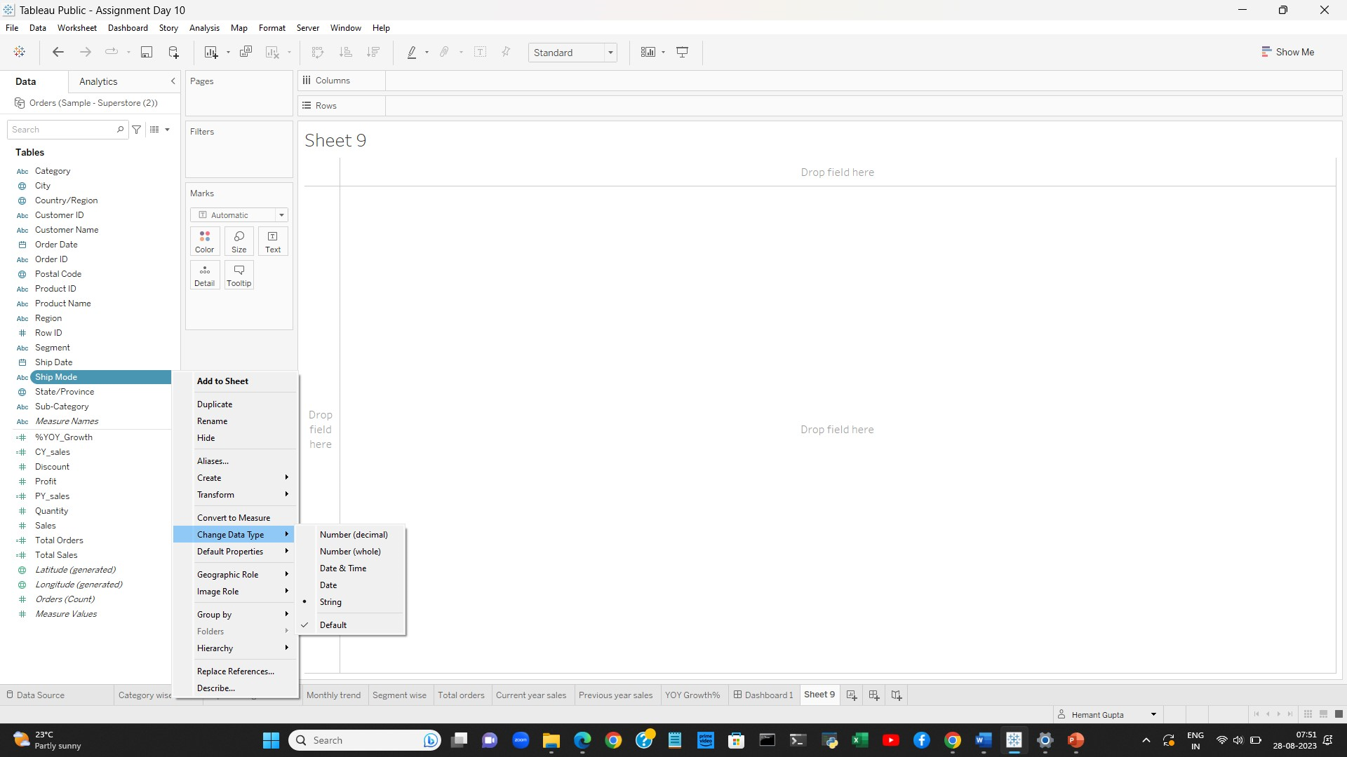
2. If you upload the data within the Tableau data field, If the user doesn't want to disturb the data source, then Click on the particular field's data type icon. A dropdown list will appear, user can choose and change from the given list of data types.

Slide 8
Thank You

